Slide 1
AWS CLI Notes
SYS-360

Slide 2
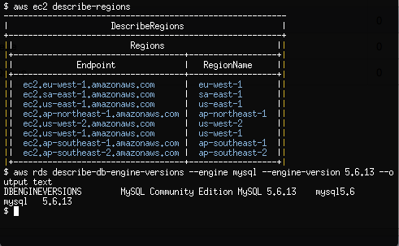
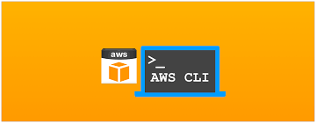
AWS CLI
Amazon AWS supports command line tools so that administrators do not have to use the AWS GUI Console.
An obvious reason is to be able to automate/script procedures within AWS.

Slide 3
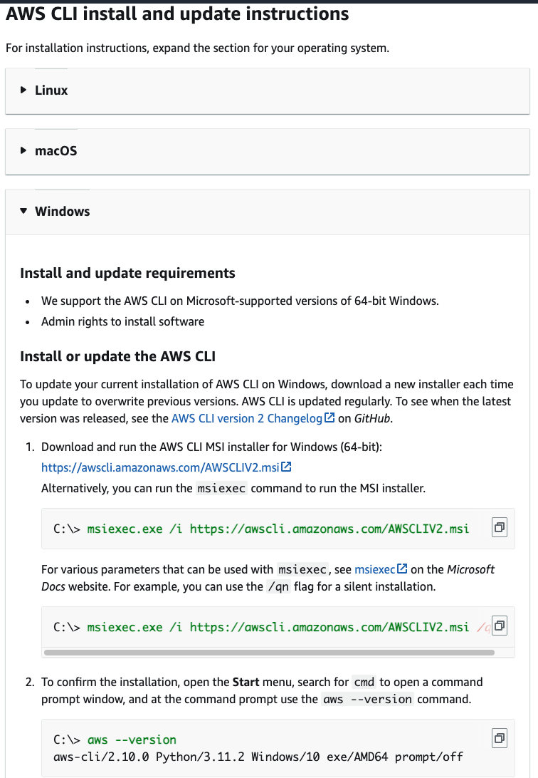
AWS CLI 2 Tools
The CLI tools (commands) for AWS come as a free installable package from Amazon for Windows, OSX, and Linux.
The current version is know as "CLI 2" which has most of the commands from the original CLI packages with modifications and new options.
V2 came out in Feb 2020 and has substantial changes from v1
NOTE: When researching syntax - a good idea to include "CLI 2" in your search query

Slide 4
AWS CLI 2 Authentication
As the CLI is using the command line to interact with services like EC2 - you are not authenticating to the AWS Console with your username/pass etc.
So, an authentication control needs to be in place!
For the CLI, AWS requires the following:
AWS Access Key ID: This is an identifier for the user (can think of it as a username)
AWS Secret Access Key: This is a private key for that user (can think of it like a password)
(optional) AWS Session Token: Token value that is good for a limited period of time - needs to be updated for subsequent operations

Slide 5
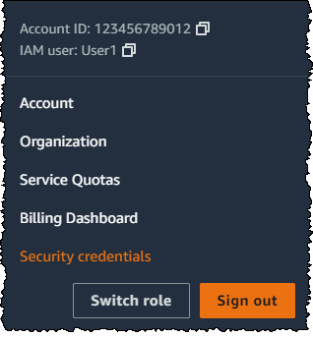
AWS CLI 2 Authentication - Finding Credentials
Again, the CLI, AWS requires the following:
AWS Access Key ID: This is an identifier for the user (can think of it as a username)
AWS Secret Access Key: This is a private key for that user (can think of it like a password)
(optional) AWS Session Token: Token value that is good for a limited period of time - needs to be updated for subsequent operations
Normally - these values are found and/or created in the AWS Console under IAM (Identity and Access Management)
However - with AWS Academy - we are using Federated Logins
(we log in through Vocareum) - and do not have Access Keys in IAM.
The Lab will show you how to receive keys and tokens in AWS Academy

Slide 6
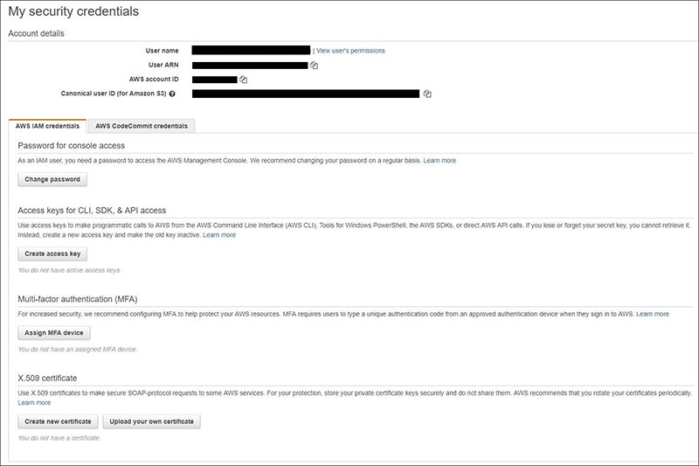
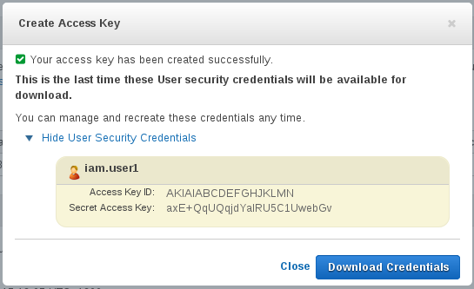
AWS CLI 2 - Creating Creds
Done in IAM Console:

Slide 7
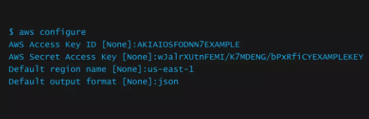
AWS CLI Config Files
To use AWS CLI, two config files need to be updated with personal information:
Stored in %USERPROFILE% (Windows) or $HOME (Linux, OSX), the two files are:
"configure" (stores default AWS region and preferred output)
and "credentials" (stores AWS Key ID, Secret Key, and Session Token (if required) - Must have permissions set to 400
Once those are set - the commands starting with "aws" should work from your terminal
Files can be manually created/edited - or use the “aws configure” command once CLI 2 is installed

Slide 8
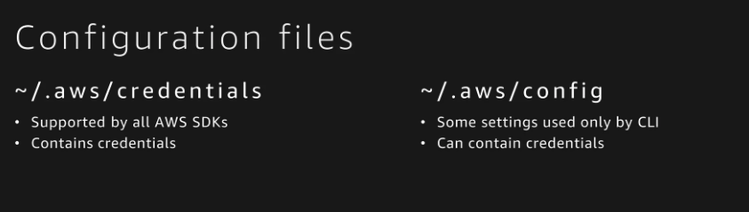
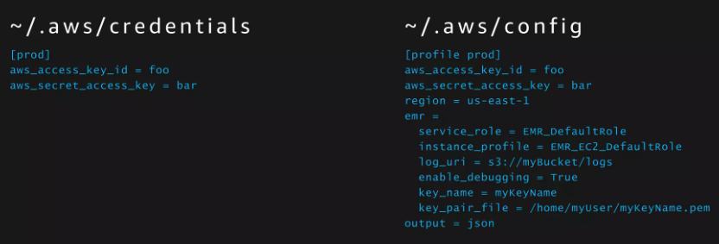

Slide 9

AWS CLI Session Token
As an additional security measure, AWS through IAM settings may require a Session Token for CLI connections
Tokens have a timeout set, so if your AWS Access Key and Secret Key are compromised, they cannot be used without the current Session Token
If Session Tokens are used, the .credentials file needs to include the current token
AWS Academy use Session Tokens - this means, you need to update your .credentials file each time you start a lab
Example .credentials entry

Slide 10
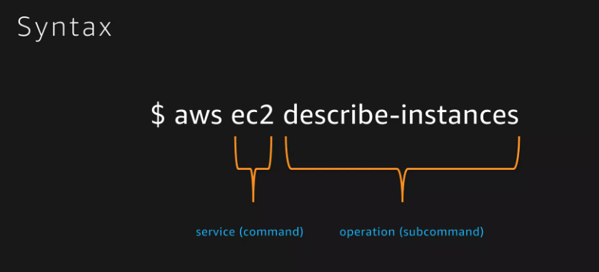
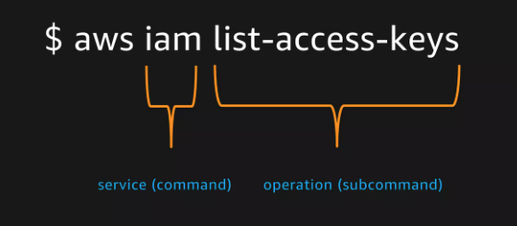

Slide 11
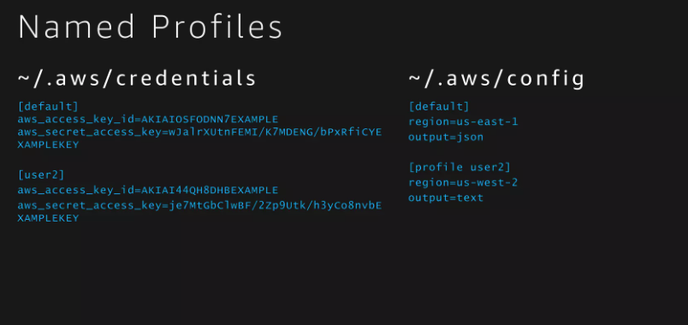
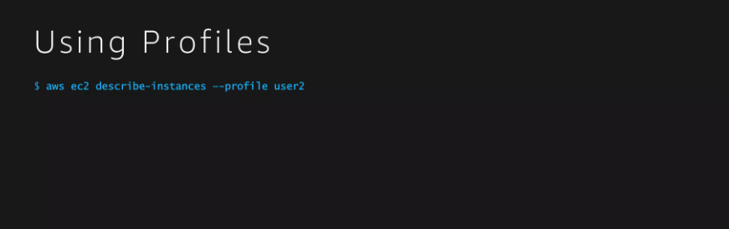

Slide 12
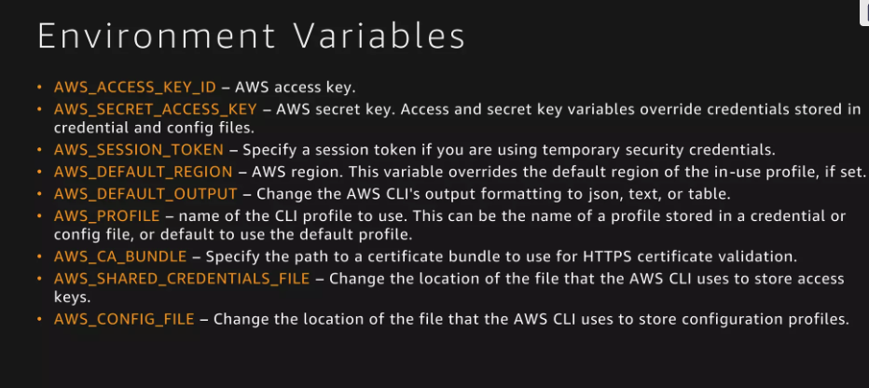
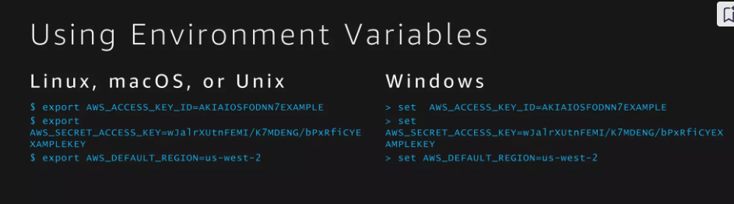

Slide 13
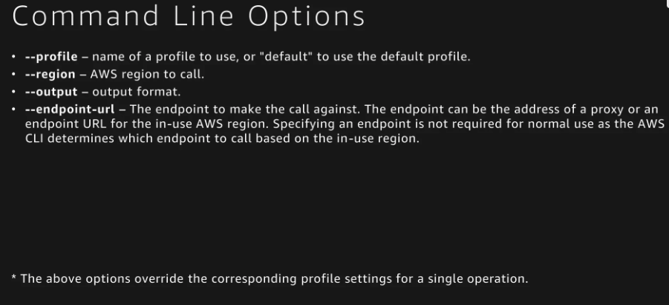

Slide 14
https://aws.amazon.com/cli/

